Slide 1
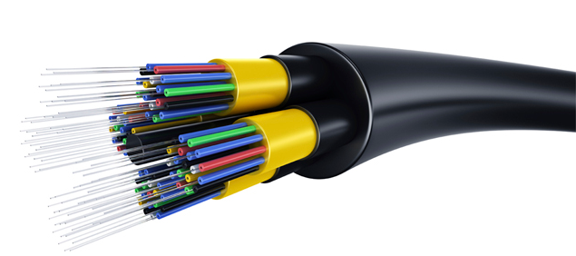
Fiber Optic Communication Systems
Lec # 01

Slide 2
Introduction
Title: Fiber Optic Communication Systems
Credit Hours: 3+1
Semester: 7th
Course Teacher: Professor Dr. Monir Morshed

Slide 3
Recommended Book:
Fiber Optic Communications by Joseph C. Palais, Latest Edition.
Reference Books:
Optical Fiber Communications: Principles and Practice by John M. Senior, Latest Edition, Prentice Hall.
Optical Fiber Communications by Gerd Keiser, Latest Edition, McGraw Hill.
Fiber-Optic Communication Systems by Govind P. Agrawal

Slide 4
Objective
To realize the significance of optical fiber communications.
To understand the construction and characteristics of optical fiber cable.
To develop the knowledge of optical signal sources and power launching.
To identify and understand the operation of various optical detectors.
To under the design of optical systems and WDM.

Slide 5
Course Contents
Overview
Historical perspectives
The basic communication systems
Nature of light
Advantages of light
Application of fiber optic communications
Optics Review
Ray theory and applications
Lenses
Imaging
Numerical aperture
Diffraction

Slide 6
Course Contents cont…
Lightwave Fundamentals
Electromagnetic waves
Dispersion, pulse dispersion and information
Polarization
Critical angle Reflections
Optic Fiber Waveguide
Step-index Fiber
Graded-index fiber
Attenuation
Pulse distortion and information rate in optic fiber
Construction of optic fiber
Optic fiber cables

Slide 7
Course Contents cont…
Light Sources
Light emitting diodes
Light emitting diodes operating characteristics
Laser principles
Laser diodes
Laser diodes operating characteristics
Distributed Feed-back Laser diodes
Optical Amplifiers
Vertical-Cavity Surface-Emitting Laser (VCSEL) Diodes
Light Detectors
Principles of photo-detection
Semiconductor photo diodes
PIN photodiodes
Avalanche Photodiodes

Slide 8
Course Contents cont…
Couplers and Connectors
Connector Principles
Splices
Connectors
Source Coupling
Distributed Networks and fiber components
FDDI, SONET, ATM,SDH,WDM
Fiber Bragg Gratings
Other components
PON
Noise and Detection
Thermal and shot noise
Signal to noise ratio
Error rates
Mode-noise, Mode partition noise, Amplifier noise, Laser noise and jitter
Additional noise contributor
Receiver circuit design

Slide 9
Course Contents cont…
Systems Design
Analog Systems design
Digital systems design
DWDM Filters
Fiber Grating Filters
Fabry Perot Filters
Multilayer Dielectric Thin-Film Filters
Mach-Zehnder Interferometers
Photonic Networks

Slide 10
Tentative Grading Policy
Attendance 10%
CT 20%
Final Paper 70%
Lab Report 20%
Lab Attendance 10%
Quiz 20%
Lab Final 50%

Slide 11

Why is this course useful to you?
Perhaps the most obvious answer is to consider the social impact of optical communications.
In 1966, two engineers at Standard Telecommunication Laboratories in England wrote a paper which in essence started the race to develop optical fiber for communications:

Slide 12

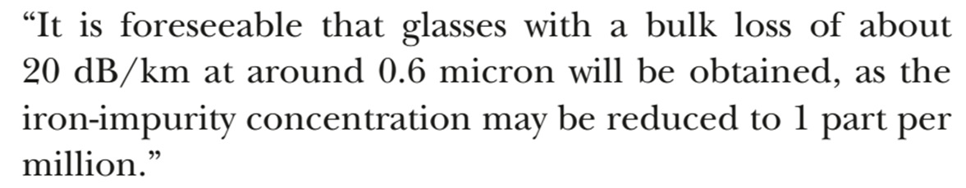
Why is this course useful to you?
One year later, the Philco-Ford company tried to predict the future; they were in many ways very close to what we have. (https://www.youtube.com/watch?v=rpq5ZmANp0k)

Slide 13

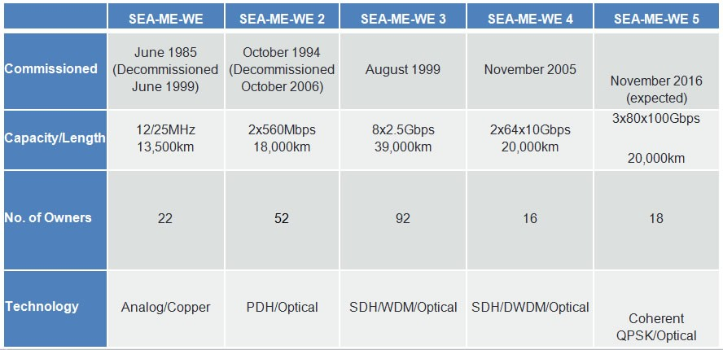
What happens in an 2021 INTERNET MINITUE?
All of this is made possible by a global infrastructure of optical cables

Slide 14
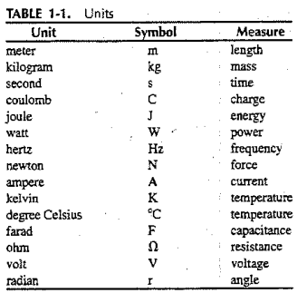
Numbers
Some basic Units that may appear frequently in this course are listed in following table for convenient reference

Slide 15
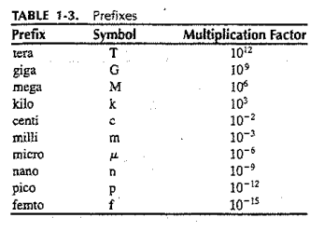
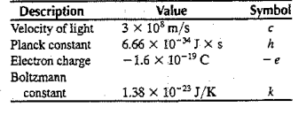
Constants & Prefixes
A few important constants and prefixes that will need to study our course.

Slide 16
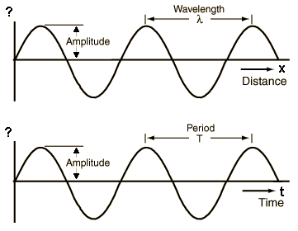
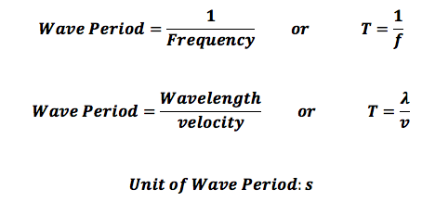
Frequency & Period
The frequency unit, the hertz, is equivalent to one cycle of oscillation per second .
The time between successive peaks of an oscillation is called the period.
If f is the wave frequency and T is its period then T=1/f.

Slide 17
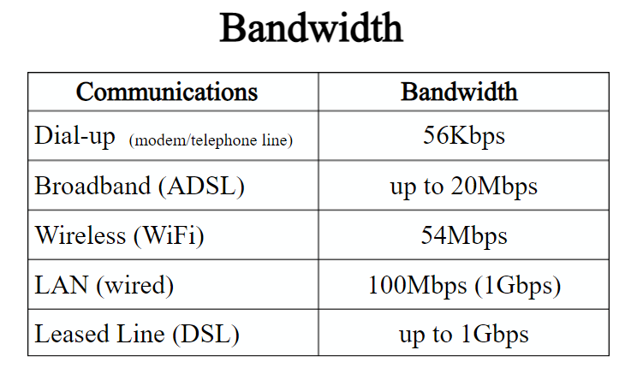
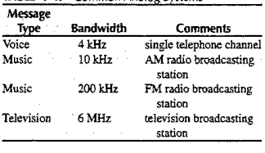
Bandwidth requirement for Common Analog Systems
Following Table, summarizes the bandwidth requirements of several analog systems.
Bandwidth:
Bandwidth is a maximum transmission rate of a communications channel.
Measure in bits per second (bps)
Kbps, Mbps, Gbps
A measure of the capacity of communication channel

Slide 18
Sampling
When analog signals are transmitted digitally, the bit rate depends on the
rate at which the analog signal is sampled
the coding scheme.
Why the standard 4-kHz telephone channel is sampled 8000 times a second?
To transmit the signal accurately, the signal should be sampled at a rate of at least twice the highest frequency contained in that signal.
For this reason the standard 4-kHz telephone channel is sampled 8000 times a second.
The coding procedure uses 8 bit to present amplitude of each sample
So a single telephone message needs 64,000 bps.

Slide 19
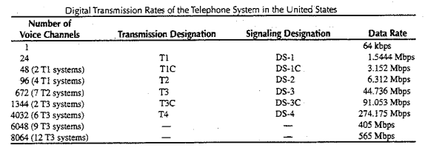
Data Rates of the Telephone Systems in the USA
A single voice channel needs 64 Kbps.
A T1 line can carry 24 voice channels or digital data rate of 1.544 Mbps.
Traditional T1 line use 2 twisted pair copper wires.
A T1 line can transmit data at a speed of 1.544 Mbps

Slide 20
SONET/SDH
Synchronous Optical Network (SONET) is a standard for synchronous data transmission on optical fibers.
SONET was developed by the Exchange Carriers Standards Association (ECSA) for the American National Standards Institute (ANSI)
The ITU-T standard is called the Synchronous Digital Hierarchy (SDH).
Background:
Before, SONET, the first generations of fiber optic systems in the public telephone network used proprietary architectures, equipment, line codes, multiplexing formats, and maintenance procedures. The user of this equipment-regional Bell operating companies and interexchange carriers (IXCs) in the united States, Canada, Korea, Taiwan, and Hong kong-wanted standards so that they could mix and match equipment from different suppliers. The task of creating such a standards was taken up in 1984 by the ECSA to establish a standard for connecting one fiber system to another. This standard is called SONET.

Slide 21
SONET VS. SDH
Together they are a set of global standards that interface equipment from different vendors. 
SDH is basically the international version of SONET, and SONET can be thought of as the North American version of SDH. 
The main differences are in the basic SDH and SONET frame formats, but SDH and SONET are essentially identical beyond the STS-3 signal level. 
The base signal for SONET is STS-1 and the base signal for SDH is STM-1. 
In SDH, both electrical and optical signals are referred to as STM signals. 
In SONET, however, electrical signals are called STS and optical signals are referred to as OC.

Slide 22
Why SONET/SDH
Reduction in equipment requirements
Increase in network reliability
Support of multiple data types (data, voice, and video)
Can carry high-level protocols such as IP
Availability of a set of generic standards that enable products from different vendors to be connected.
A flexible architecture capable of future applications, with variety of transmission rates.
To accommodate existing signal structure

Slide 23
SONET Signals
SONET defines a hierarchy of electrical signaling levels called synchronous transport signals (STSs). 
Each STS level (STS-1 to STS- 768) supports a certain data rate, specified in megabits per second (see table in next slide).
The corresponding optical signals are called optical carriers (OCs). 
SDH specifies a similar system called a synchronous transport module (STM). 
STM is compatible with existing European hierarchies, such as E-lines, and with STS levels. 
The lowest STM level, STM-1, is defined as 155.520 Mbps, which is exactly equal to STS-3. 
The STS-3 rate is exactly three times the STS-1 rate; and the STS-9 rate is exactly one-half the STS-18 rate. 
These relationships mean that 18 STS-1 channels can be multiplexed into one STS-18, six STS-3 channels can be multiplexed into one STS-18, and so on.

Slide 24
SONET/SDH Rates
STS | OC | Rate(Mbps) | STM
STS-1 | OC-1 | 51.840
STS-3 | OC-3 | 155.520 | STM-1
STS-9 | OC-9 | 466.560 | STM-3
STS-12 | OC-12 | 622.080 | STM-4
STS-18 | 0C-18 | 933.120 | STM-6
STS-24 | OC-24 | 1244.160 | STM-8
STS-36 | 0C-36 | 1866.320 | STM-12
STS-48 | OC-48 | 2488.320 | STM-16
STS-96 | 0C-96 | 4976.640 | STM-32
STS-192 | 0C-192 | 9953.280 | STM-64
STS-768 | 0C-768 | 39813.120 | STM-256

Slide 25
Synchronous vs. Asynchronous
Clocking means using a series of repetitive pulses to keep the bit rate of data constant and to indicate where the ones and zeroes are located in a data stream.
Asynchronous multiplexing uses multiple stages.
Extra bits are added (bit-stuffing) for DS-1s multiplexing to account for the variations of each individual stream and combined with other bits (framing bits) to form a DS-2 stream.
Again bit-stuffing is used to multiplex up to DS-3.
DS-3s are multiplexed up to higher rates in the same manner.
At the higher asynchronous rate, they cannot be accessed without demultiplexing.
In a synchronous system such as SONET, the average frequency of all clocks in the system will be the same (Synchronous), or nearly the same (plesiochronous).
Many Synchronous signals to be stacked together when multiplexed without any bit-stuffing.
The STS-1s are easily accessed at a higher STS-N rate.

Slide 26
SONET Devices
SONET transmission relies on three basic devices:
STS multiplexers/demultiplexers, 
Regenerators, 
add/drop multiplexers and terminals.
ADM
STS
DEMUX
T
R
R
R
T
T
Add
Drop
Section
Section
Section
Section
Section
STS Line
STS Line
STS Path
ADM: Add/drop multiplexer
STS MUX: Synchronous transport signal multiplexer
STS DEMUX: Synchronous transport signal demultiplexer
R: Regenerator
T: Terminal


Slide 27
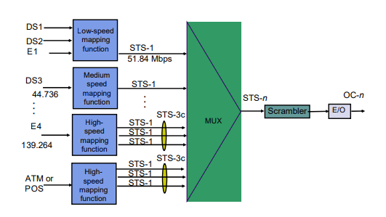
SONET Devices
STS multiplexers/demultiplexers:
It is the beginning points and endpoints of a SONET link.
They provide the interface between an electrical tributary network and the optical network. 
An STS multiplexer multiplexes signals from multiple electrical sources and creates the corresponding OC signal and an STS demultiplexer demultiplexes an optical OC signal into corresponding electric signals.

Slide 28
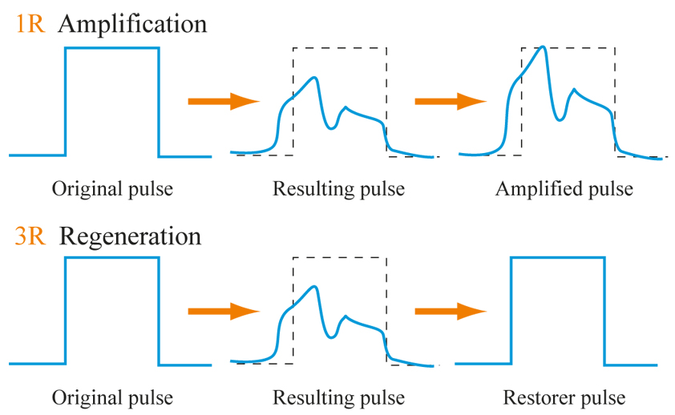
SONET Devices
Regenerator:
Regenerators extend the length of the links. 
It is a repeater that takes a received optical signal (OC-n), demodulates it into the corresponding electric signal (STS-n), regenerates the electric signal, and finally modulates the electric signal into its correspondent OC-n signal. 

Slide 29
SONET Devices
Add/drop Multiplexer:
Add/drop multiplexers (ADMs) allow insertion and extraction of signals. 
ADM can add STSs coming from different sources in to a given path or can remove a desired signal from a path and redirect it without demultiplexing the entire signal. 
Instead of relying on timing and bit positions, add/drop multiplexers use header information such as addresses and pointers to identify individual streams.
Terminals:
 A terminal is a device that uses the services of a SONET network.

Slide 30
SONET Devices
Section:
SONET Devices  A section is the optical link connecting two neighbor devices: multiplexer to multiplexer, multiplexer to regenerator, or regenerator to regenerator.
Lines :
A line is the portion of the network between two multiplexers: STS multiplexer to add/drop multiplexer, two add/drop multiplexers, or two STS multiplexers .
Paths :
 A path is the end-to-end portion of the network between two STS multiplexers.  In a simple SONET of two STS multiplexers linked directly to each other, the section, line, and path are the same.

Slide 31
SONET Layers Architecture
SONET defines four layers: path, line, section, and photonic
Path layer
Line layer
Data link
Section layer
Physical
Photonic layer
The path layer: The path layer is responsible for the movement of a signal from its optical source to its optical destination. 
The signal is changed from an electronic form into an optical form, multiplexed with other signals, and encapsulated in a frame. 
At the optical destination, the received frame is demultiplexed, and the individual optical signals are changed back into their electronic forms. 
Path layer overhead is added here and make SPE.
Data identification inside the SPE
Path end to end verification.
Path status check-in
 STS multiplexers provide path layer functions.

Slide 32
SONET Layers Architecture
The line layer: The line layer is responsible for the movement of a signal across a physical line such as MUX, DEMUX, and ADM.
Line layer overhead overhead is added to the frame at this layer.
Error checking over a line.
Operation, Administration, and maintenance signaling over a line.
Order wire communication over line level
Automatic protection switching
STS multiplexers and add/drop multiplexers provide line layer functions.
The section layer: The section layer is responsible for the movement of a signal across a physical section.
 It handles framing, scrambling, and error control.
Operation, Administration, and maintenance signaling over a section.
Section layer overhead is added to the frame at this layer.
The photonic layer: The photonic layer corresponds to the physical layer of the OSI model.
 It includes physical specifications for the optical fiber channel, the sensitivity of the receiver, multiplexing functions, and so on.
SONET uses NRZ encoding with the presence of light representing 1 and the absence of light representing 0.

Slide 33
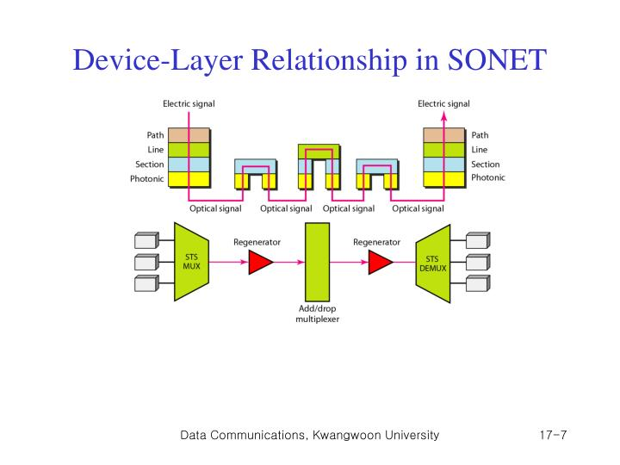
Device-Layer Relationships
Figure shows the relationship between the devices used in SONET transmission and the four layers of the standard. 
An STS multiplexer is a four layer device. 
An add/drop multiplexer is a three layer device. 
A regenerator is a two layer device.

Slide 34
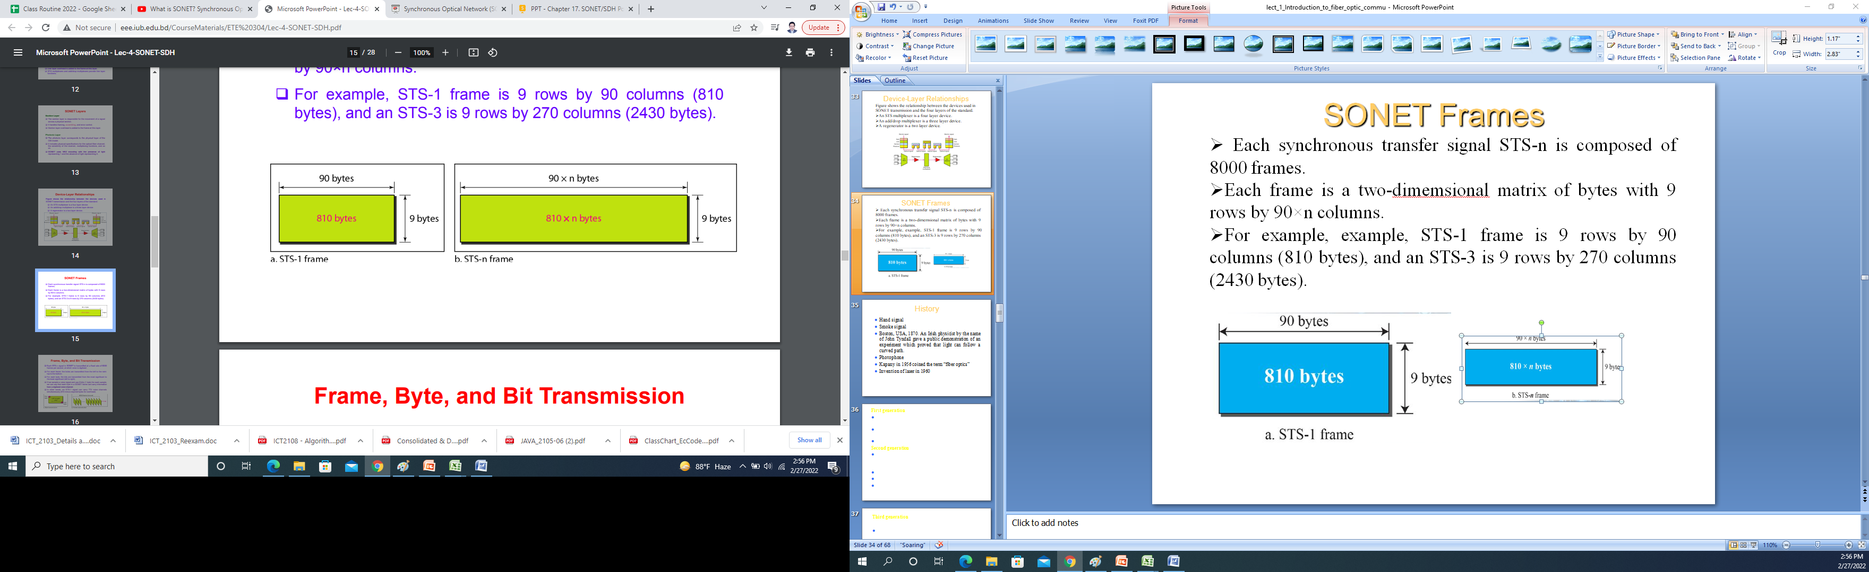
SONET Frames
Each synchronous transfer signal STS-n is composed of 8000 frames.  
Each frame is a two-dimemsional matrix of bytes with 9 rows by 90×n columns. 
For example, STS-1 frame is 9 rows by 90 columns (810 bytes), and an STS-3 is 9 rows by 270 columns (2430 bytes).

Slide 35
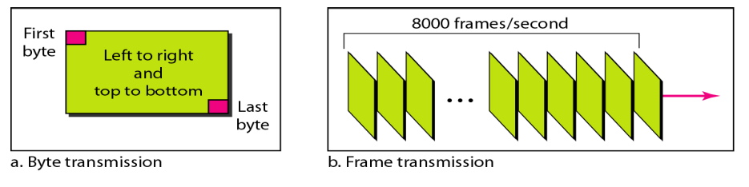
Frame, Byte, and Bit Transmission
Each STS-n signal in SONET is transmitted at a fixed rate of 8000 frames per second, at which voice is digitized. 
For each frame, the bytes are transmitted from the left to the right, top to the bottom. 
For each byte, the bits are transmitted from the most significant to the least significant (left to right). 
If we sample a voice signal and use 8 bits (1 byte) for each sample, we can say that each byte in a SONET frame can carry information from a digitized voice channel. 
In other words, an STS-1 signal can carry 774 voice channels simultaneously (810 minus required bytes for overhead).

Slide 36
Example:
Find the data rate of an STS-1 signal.
Solution: STS-1, like other STS signals, sends 8000 frames per second. Each STS-1 frame is made of 9 by (1 × 90) bytes. Each byte is made of 8 bits. The data rate is: STS data rate= 8000×9×(1×90)×8= 51.840 Mbps
Find the data rate of an STS-3 signal.
Solution: STS-3, like other STS signals, sends 8000 frames per second. Each STS-3 frame is made of 9 by (3 × 90) bytes. Each byte is made of 8 bits. The data rate is: STS data rate= 8000×9×(3×90)×8= 155.52 Mbps
What is the duration of an STS-1 frame? STS-3 frame? STS-n frame?
Solution: In SONET, 8000 frames are sent per second. This means that the duration of an STS-1, STS-3, or STS-n frame is the same and equal to 1/8000 s, or 125 μs.
In SONET, the duration of any frame is 125 μs.

Slide 37
STS-1 Frame Format
A SONET frame is a matrix of 9 rows of 90 bytes (octets ) each, for a total of 810 bytes. 
The upper three rows of the first three columns are used for section overhead (SOH).  The lower six are line overhead (LOH). 
The rest of the frame is called the synchronous payload envelope (SPE). It contains user data and path overhead (POH) needed at the user data level.
Path Overhead
90 Columns/90 octets per row
A1 | A2 | J0 | J1
B1 | E1 | F1 | B3
D1 | D2 | D3 | C2
H1 | H2 | H3 | G1
B2 | K1 | K2 | F2
D4 | D5 | D6 | H4
D7 | D8 | D9 | Z3
D10 | D11 | D12 | Z4
Z1 | Z2 | E2 | N1
Section overhead
SPE-
user data
and
path overhead
9 Rows×87 Columns
Line overhead
87 Columns-Synchronous payload envelope (SPE)

Slide 38
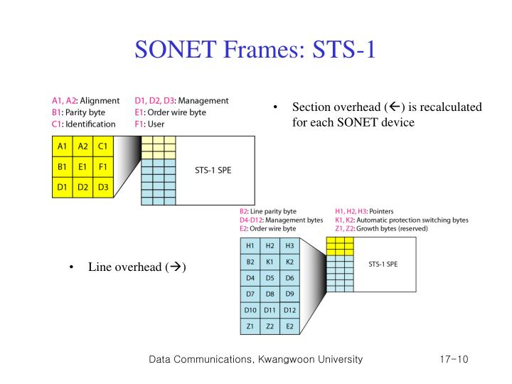
Overhead
Allowing simpler multiplexing
Greatly expanded operations, administration, maintenance, and provisioning (OAM&P)capabilities.
Section Overhead:
Performance monitoring (STS-N signal).
Local order wire.
Data communication channels to carry information for OAM&P
framing

Slide 39
Overhead
Line Overhead: The line overhead supports the following functions
Locating the SPE in the frame
Multiplexing or concatenating signals
Performance monitoring
Automatic protection switching
Line maintenance

Slide 40
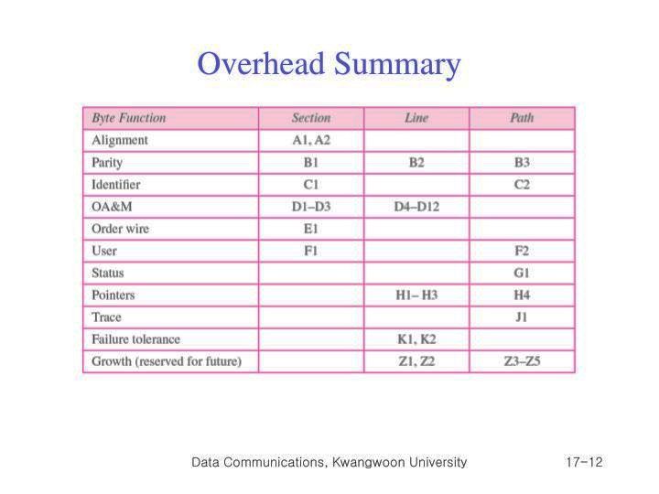
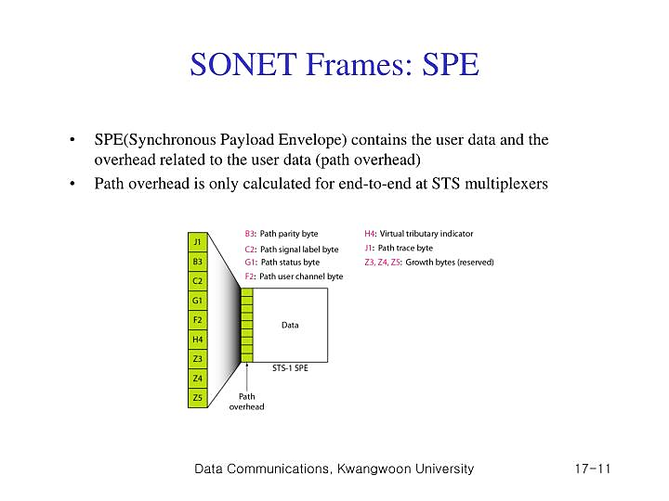
Overhead
Path Overhead: The path overhead supports the following functions
Performance monitoring of the STS SPE
Signal label (the content of the STS SPE, including status of mapped payloads)
Path status
Path trace

Slide 41
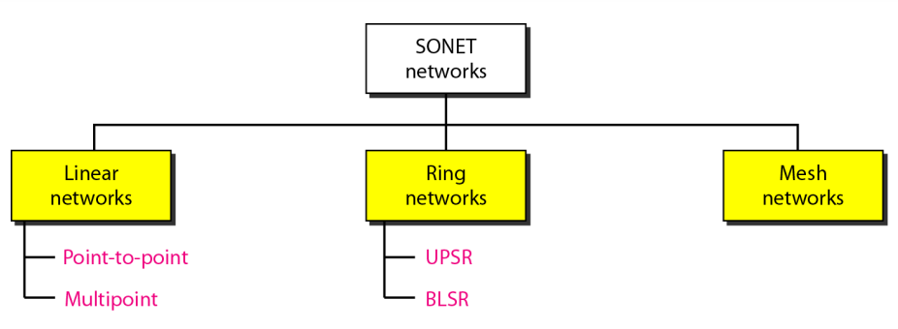
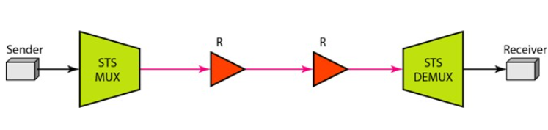
SONET network
Using SONET equipment, we can create a SONET network that can be used as a high-speed backbone carrying loads from other networks such as ATM or IP. 
We can roughly divide SONET networks into three categories: linear, ring, and mesh networks,
Point to Point Network: A point-to-point network is normally made of an STS multiplexer, an STS demultiplexer, and zero or more regenerators with no add/drop multiplexers. The signal flow can be unidirectional or bidirectional
Fig. Point to Point Network

Slide 42
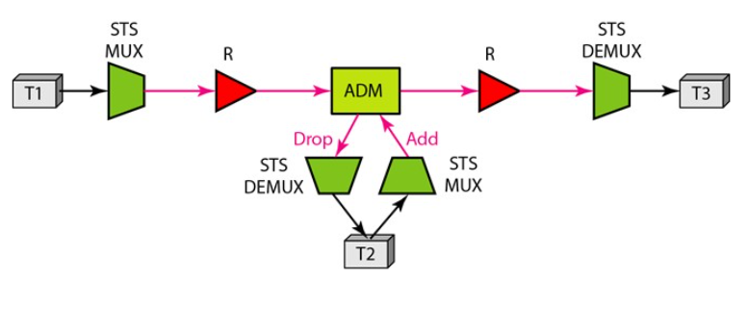
SONET network
Multipoint Network:
A multipoint network uses ADMs to allow the communications between several terminals.
An ADM removes the signal belonging to the terminal connected to it and adds the signal transmitted from another terminal.
Each terminal can send data to one or more downstream terminals.
Figure 9.19 shows a unidirectional scheme in which each terminal can send data only to the downstream terminals, but a multipoint network can be bidirectional, too.
Fig. Multipoint Network

Slide 43
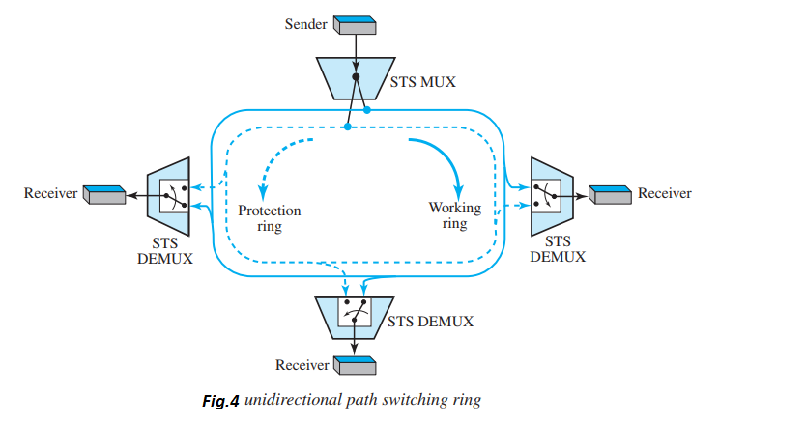
SONET network
Ring Network:
 SONET networks today use a combination of interconnected rings to create services in a wide area. 
A SONET network may have a regional ring, several local rings, and many site rings to give services to a wide area.  These rings can be UPSR, BLSR, or a combination of both.
Fig. Unidirectional Path Switching Ring (UPSR)

Slide 44
SONET network
Unidirectional path switching ring (UPSR):
 A unidirectional path switching ring (UPSR) is a unidirectional network with two rings: one ring used as the working ring and the other as the protection ring. 
The same signal flows through both rings, one clockwise and the other counterclockwise. It is called UPSR because monitoring is done at the path layer. 
A node receives two copies of the electrical signals at the path layer, compares them, and chooses the one with the better quality. 
If part of a ring between two ADMs fails, the other ring still can guarantee the continuation of data flow. 
UPSR has fast failure recovery, but it is not efficient because we need to have two rings that do the job of one. Half of the bandwidth is wasted! 
The sender uses a two-way connection to send data to both rings simultaneously; the receiver uses selecting switches to select the ring with better signal quality. 
One STS multiplexer and three STS demultiplexers to emphasize that nodes operate on the path layer.

Slide 45
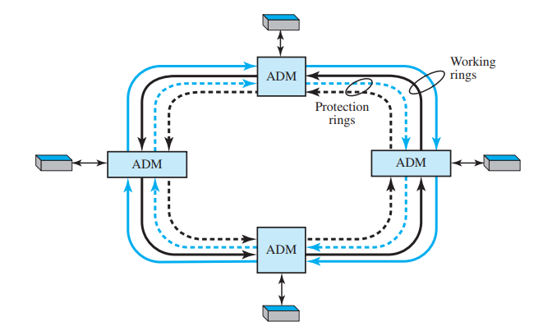
SONET network
Bidirectional line switching ring (BLSR):
 In this case, communication is bidirectional, which means that we need two rings for working lines. 
We also need two rings for protection lines This means BLSR uses four rings.
 If a working ring in one direction between two nodes fails, the receiving node can use the reverse ring to inform the upstream node in the failed direction to use the protection ring. 
The network can recover in several different failure situations. 
The discovery of a failure in BLSR is at the line layer, not the path layer.  The ADMs find the failure and inform the adjacent nodes to use the protection rings.
Fig. Bidirectional Line Switching Ring (BLSR)

Slide 46
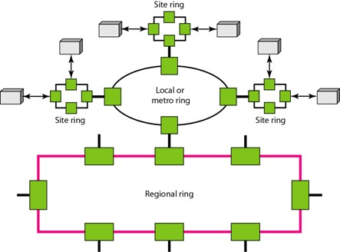
SONET network
Combination of Rings:
  SONET networks today use a combination of interconnected rings to create services in a wide area. 
A SONET network may have a regional ring, several local rings, and many site rings to give services to a wide area. 
These rings can be UPSR, BLSR, or a combination of both.
Fig. Combination of Rings

Slide 47
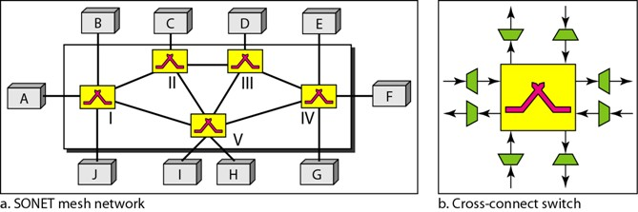
SONET network
Mesh Networks:
  One problem with ring networks is the lack of scalability.  When the traffic in a ring increases, we need to upgrade not only the lines, but also the ADMs. 
In this situation, a mesh network with switches probably give better performance. 
A switch in a network mesh is called a cross-connect, has input and output ports.  In an input port, the switch takes an OC-n signal, changes it to an STS-n signal, demultiplexes it into the corresponding STS-1 signals, and sends each STS-1 signal to the appropriate output port. 
An output port takes STS-1 signals coming from different input ports, multiplexes them into an STS-n signal, and makes an OC-n signal for transmission.
SONET mesh network
Cross-connect Switch

Slide 48
Computing power levels
(decibels)
To design an optical fiber communication systems, it is important to account the optical power.
This power measurement helps to ensure that incident wave on the detector has sufficient strength to be clearly and correctly recognized.
In other instances the received power may even be too large for the receiver.
The designer must be certain this does not occur.
If the power is P₁ watts at one point in the system and P₂ watts at some point farther along the link, then P₂/P₁ is the fraction of the power transmitted between the two locations
dB=10 log₁₀P₂/P₁
or, P₂=P₁ 10 ^{dB/10}

Slide 49
Decibels (dB) Calculation
If we consider power levels in a cascaded system of the following figure:
P₂
P₃
P₁
P₄
The output power is determined by:
The logarithmic scale is used to ease with which total change in power level is found when several elements are cascaded:

Slide 50
Example
Suppose that the three elements in the following figure have losses -11,-6 and -3 dB respectively. Find the total loss of the combination. Find the output power if the input power is 5mW.
P₂
P₃
P₁
P₄
Solution: The total loss is =-11-6-3=-20dB

Slide 51
Example
A system has -23 dB of loss. Compute its efficiency.
A light emitting diode radiates 2mW. Compute the dBm value of this radiated power. The power travels through a group of components having a combined loss of 23 dB. Compute the output power.

